Slide 1
hOTEL DBMS by using PostgreSQL
Amina mustafna
se – 2017

Slide 2
Introduction
For any business organization, in IT sector the most important part is data software.
The idea of the project is that people can get information about hotel rooms and facilities. Whether the room is booked or not, room category:de luxe or business room, whether the room has air conditioning, room rental, etc.

Slide 3
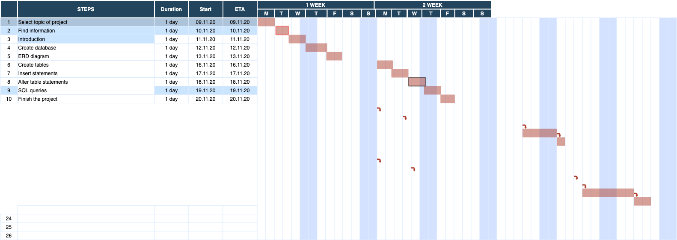
GANTT CHART

Slide 4
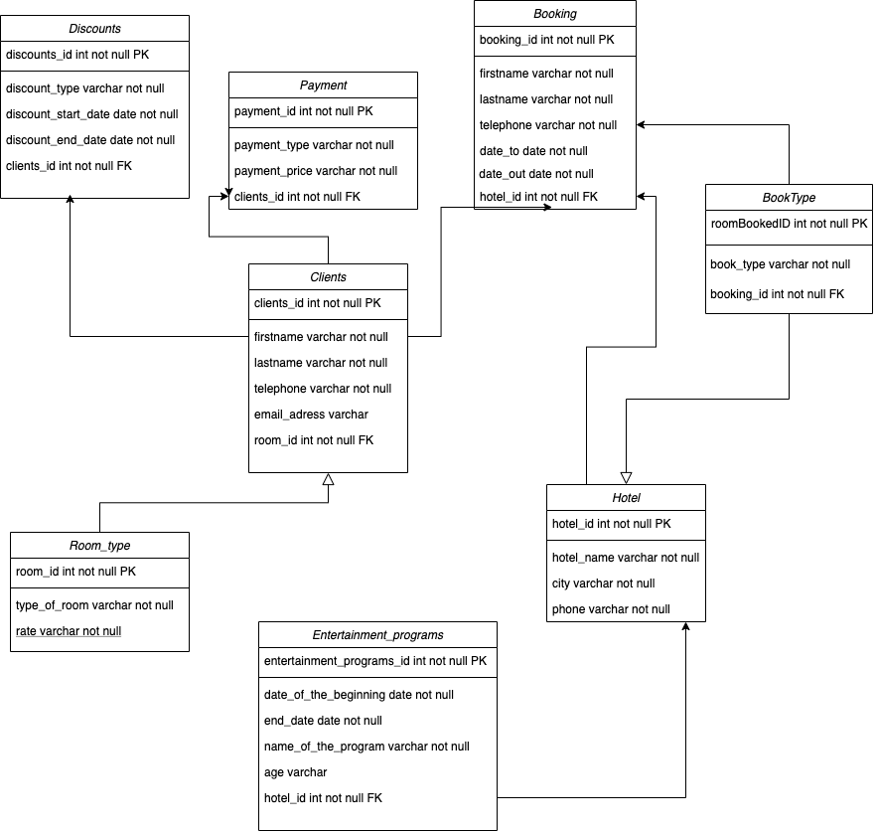
ERD DIAGRAM

Slide 5
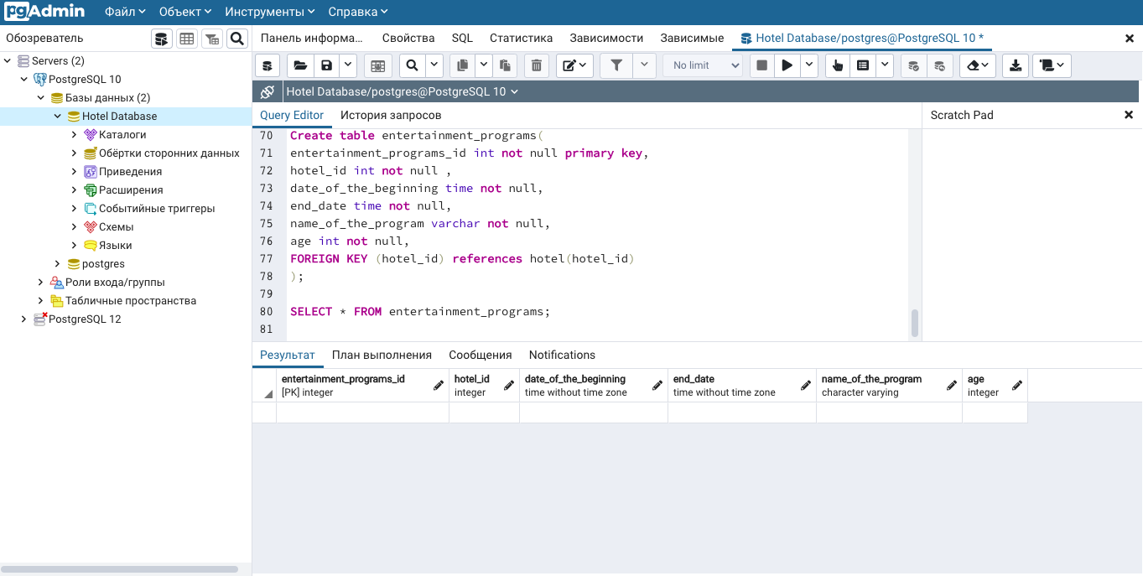
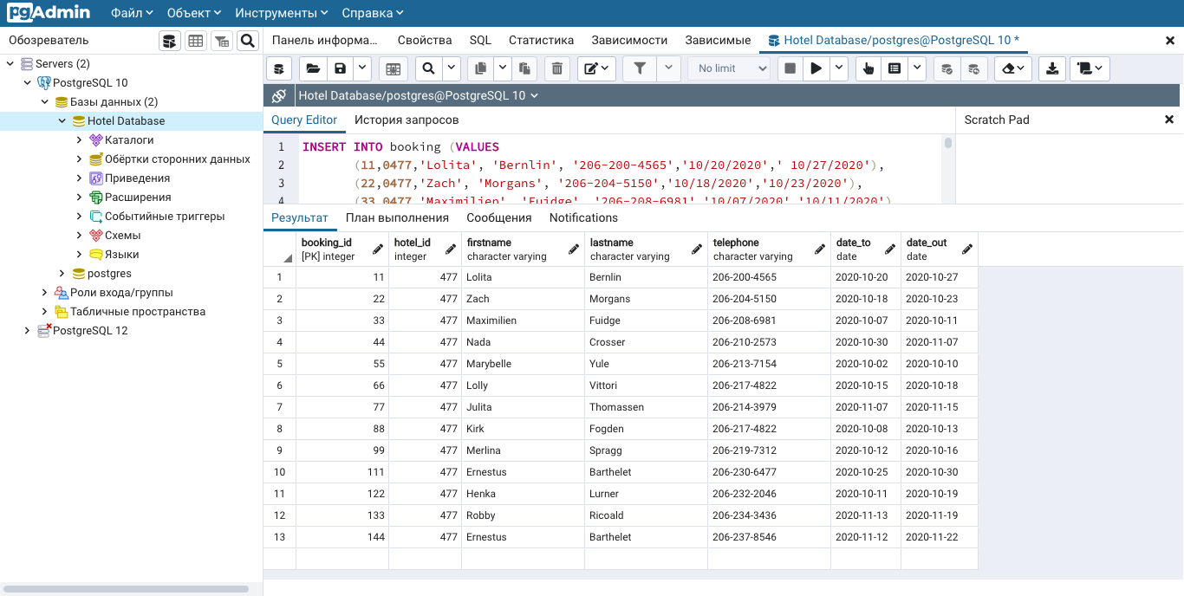
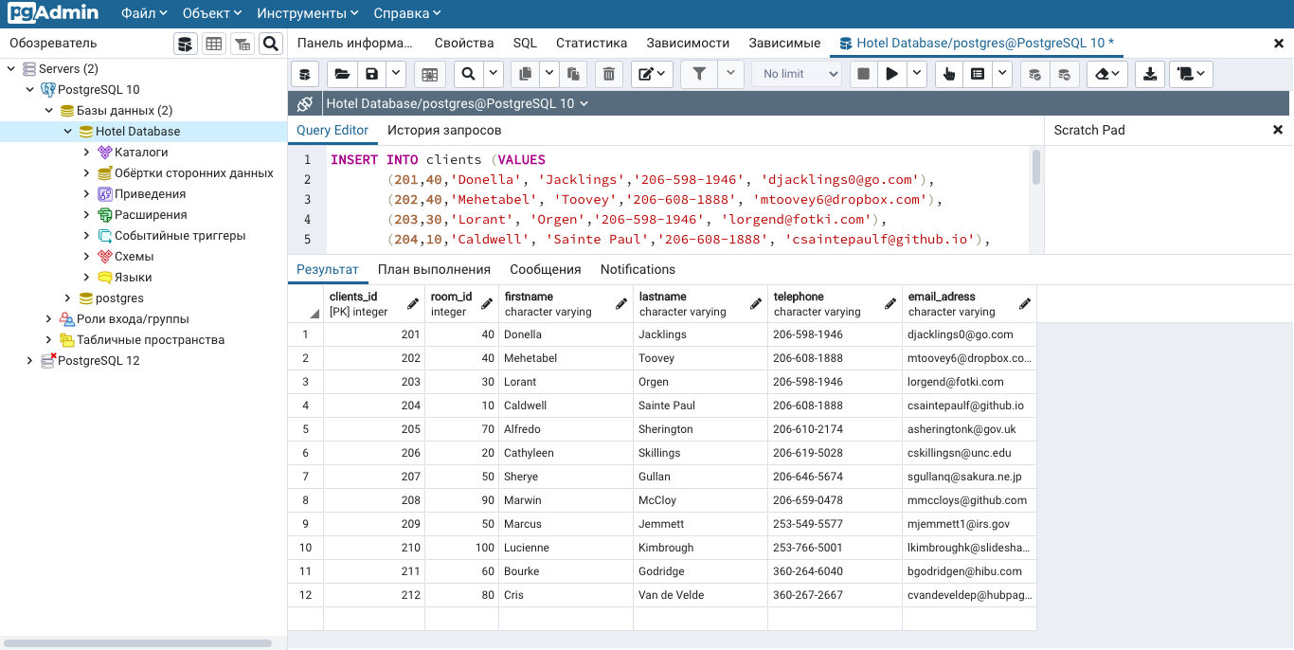
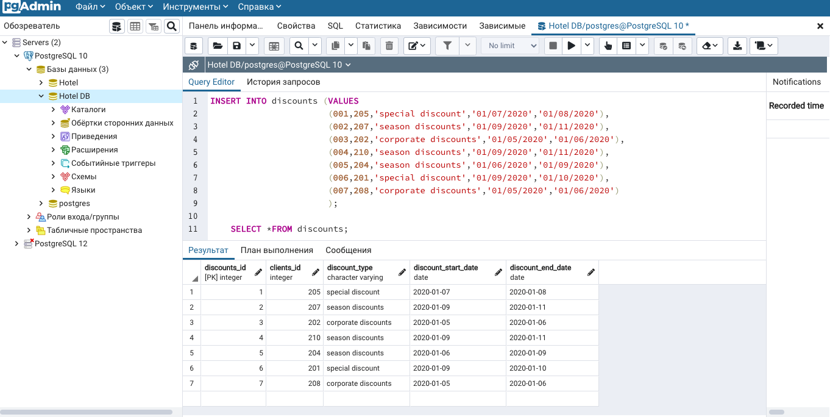
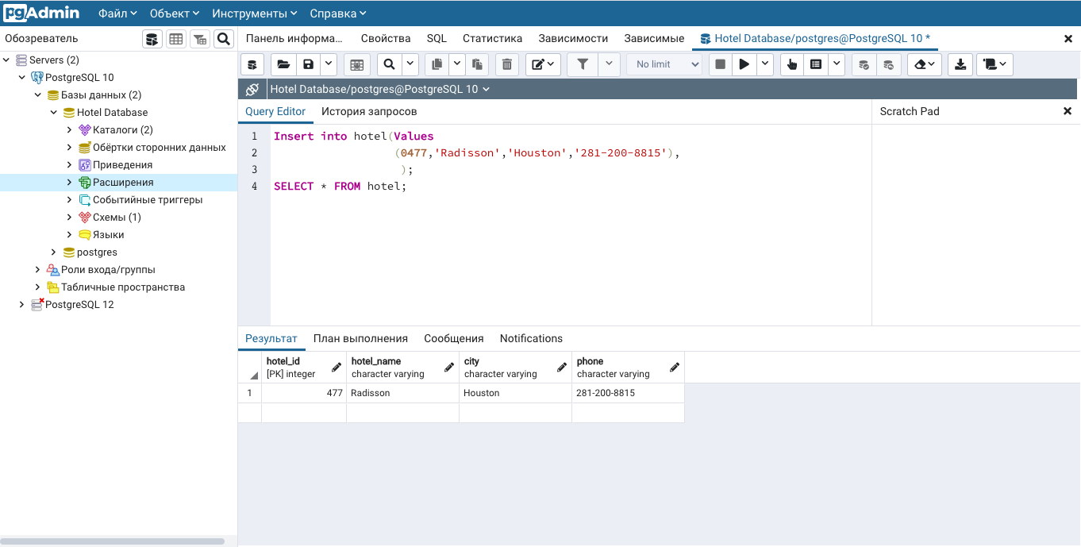
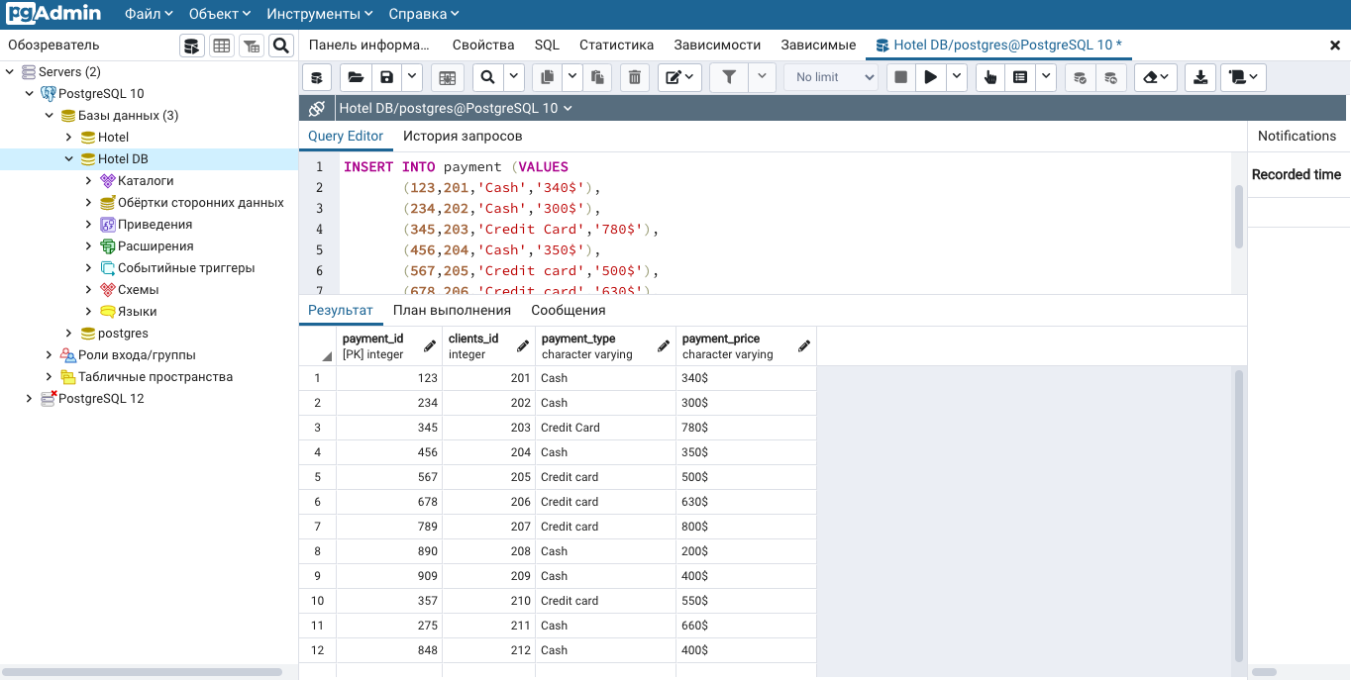
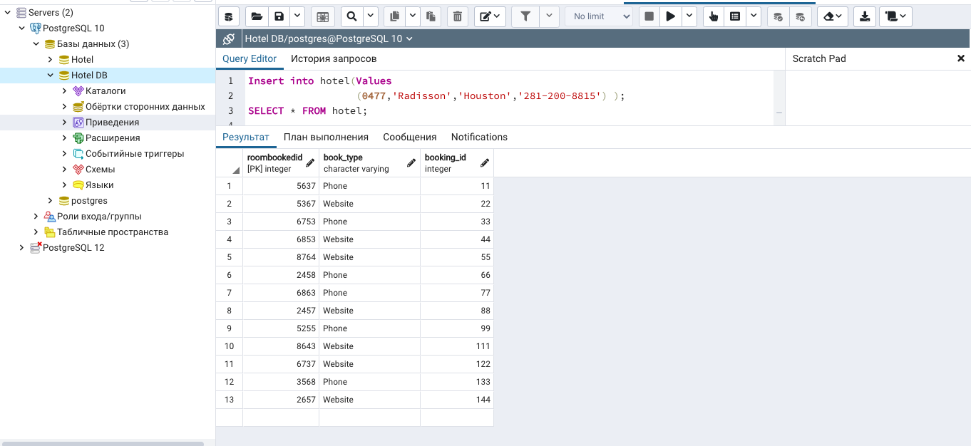
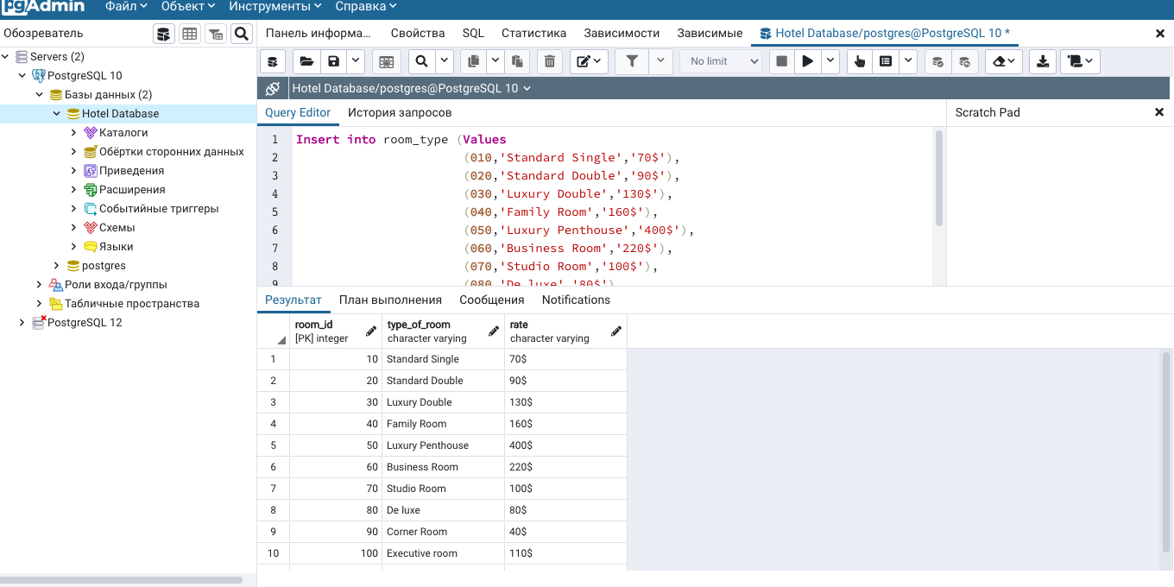
T A B L E S

Slide 6
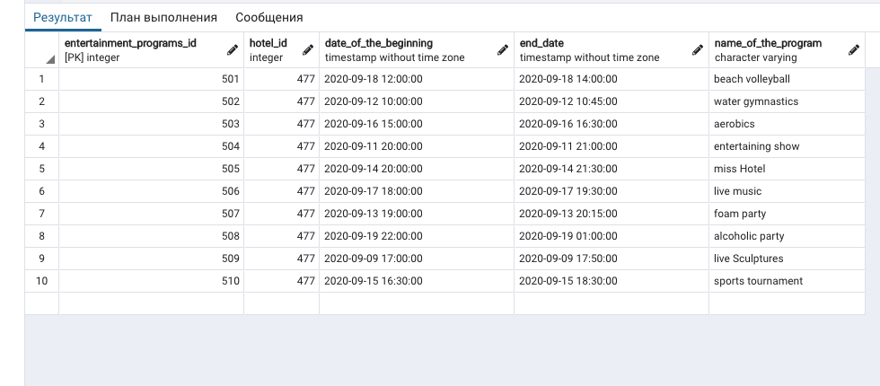
Insert statement

Slide 7
INSERT STATEMENT

Slide 8


ALTER TABLE STATEMENTS

Slide 9

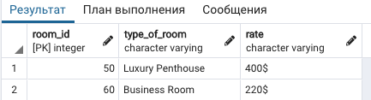
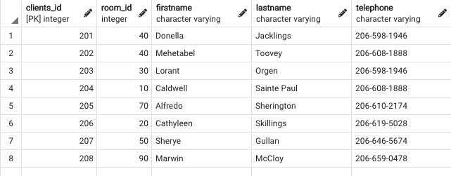
SQL QUERIES

Slide 10
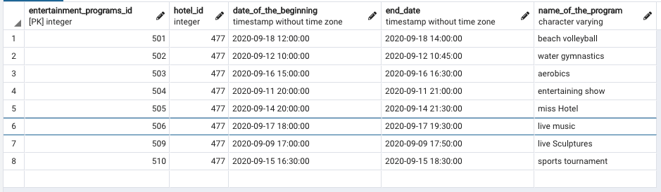



SQL QUERIES

Slide 11

Thank you for your attention!

